Slide 1


Making IT Rain with Cloud Computing
Tom Soderstrom
IT Chief Technology Officer
and
Khawaja Shams
Missions Cloud Expert
Jet Propulsion Laboratory, California Institute of Technology.
“One must learn by doing the thing;
for though you think you know it, you have no certainty until you try.” - Sophocles
Copyright 2011 California Institute of Technology. Government sponsorship acknowledged

Slide 2
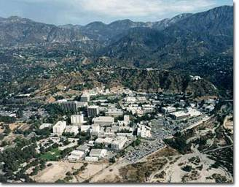
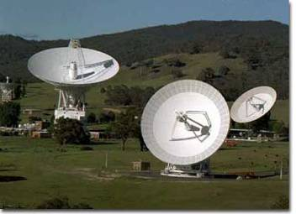

JPL is part of both NASA and Caltech
JPL is a Federally Funded Research and Development Center (FFRDC) Managed by CalTech for NASA
NASA’s lead center for robotic exploration of the solar system. Have 19 spacecraft and 9 instruments across the solar system and beyond
$1.7B contract per year, ~ 5,000 employees; 177 acre facility located in Pasadena, CA, with 670K sq.ft of office space and 900K sq.ft. of labs
Manages worldwide Deep Space Network
  3 Locations - Goldstone CA, Madrid Spain, Canberra Australia
  Spacecraft Command & Control - Recording scientific data
50+ years experience in spacecraft design, production, operation
JPL spacecraft have visited all planets in our solar system except Pluto!

Slide 3
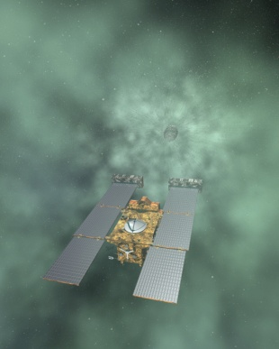
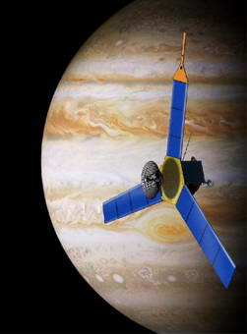
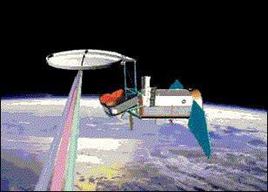
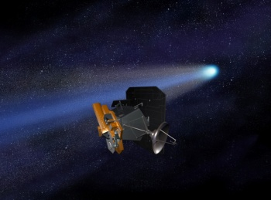
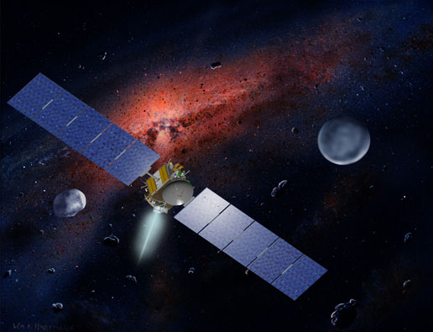
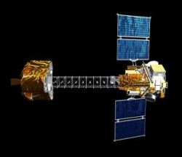
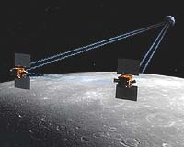
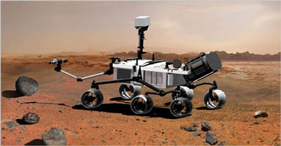
Upcoming Mars & Solar System
Exploration Events
EPOXI
Comet Flyby
November 2010
Stardust- NExT
Comet Flyby
February 2011
Supafrk105
Aquarius
April 2011
Juno
August 2011
Dawn Vesta Arrival
August 2011
(Ceres, February 2015)
GRAIL
September 2011
Mars Science Laboratory November 2011
NuSTAR
January 2012
Notes:
The EPOXI flyby of comet Hartley-2 will occur on November 4, 2010. The spacecraft will fly by the nucleus at a distance of 700km, and a flyby velocity of approximately 12 km/sec.
Stardust-NExT will complete the NExT mission by flying by comet Tempel-1 at a distance of 200km and a flyby velocity of approximately 10km/sec on February 15, 2011. Tempel-1 is the same comet that Deep Impact penetrated on July 4, 2005.
Aquarius – Launch: April 2011. This mission will provide the first-ever global maps of salt concentrations in the ocean surface needed to understand heat transport and storage in the ocean.
JUNO – Launch: August 2011. This mission will conduct an in-depth study of the giant gas planet Jupiter.
Dawn Vesta asteroid arrival: August 2011. (Launched September 2007). Dawn, the first spacecraft ever planned to orbit two different bodies after leaving Earth, will orbit Vesta and Ceres, two of the largest asteroids in the solar system.
GRAIL – Will measure the Moon’s gravity fields in unprecedented detail. Launch September 2011. The Gravity Recovery And Interior Laboratory, or GRAIL, mission will fly twin spacecraft in tandem orbits around the moon for three months to measure its gravity field in unprecedented detail.
MSL aka Curiosity – Is a long range, long duration rover that will drive on and measure the surface of Mars paving the way for a future sample return mission. The name Curiosity was coined by a 12 year-old girl named Ma from Santa Clara, CA. Launch November 2011.
NuSTAR – Nuclear Spectroscopic Telescope Array will study the sky through X-Ray. It’s a pathfinder mission that will open the high energy X-ray sky for sensitive study for the first time, answering fundamental questions of how black holes are distributed throughout the cosmos, how the elements were forged in the explosions of massive stars, and what powers the most extreme active galaxies. Launch January 2012. The spacecraft will fly aboard a Pegasus XL rocket from the Ronald Reagan Ballistic Missile Defense Test Site located at the Pacific Ocean's Kwajalein Atoll.

Slide 4
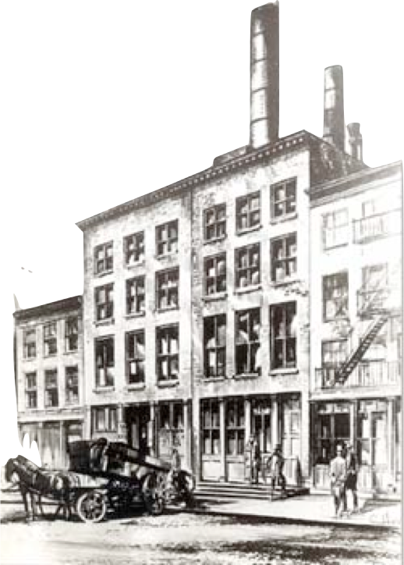

PEARL STREET STATION

Slide 5
Mission Operations Computers
Infrastructure
Cost $
Missed deadline
Large
Capital
Expenditure
Predicted
Demand
Opportunity
Cost
Traditional
Hardware
Actual
Demand
Automated
Virtualization
JPL Mission
time

Slide 6
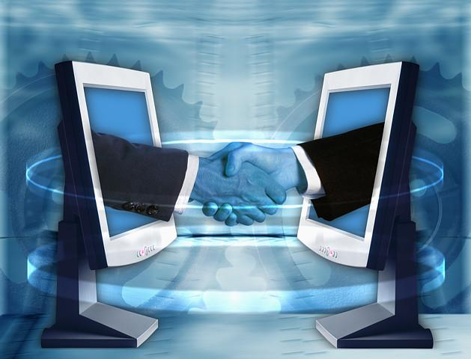

Slide 7
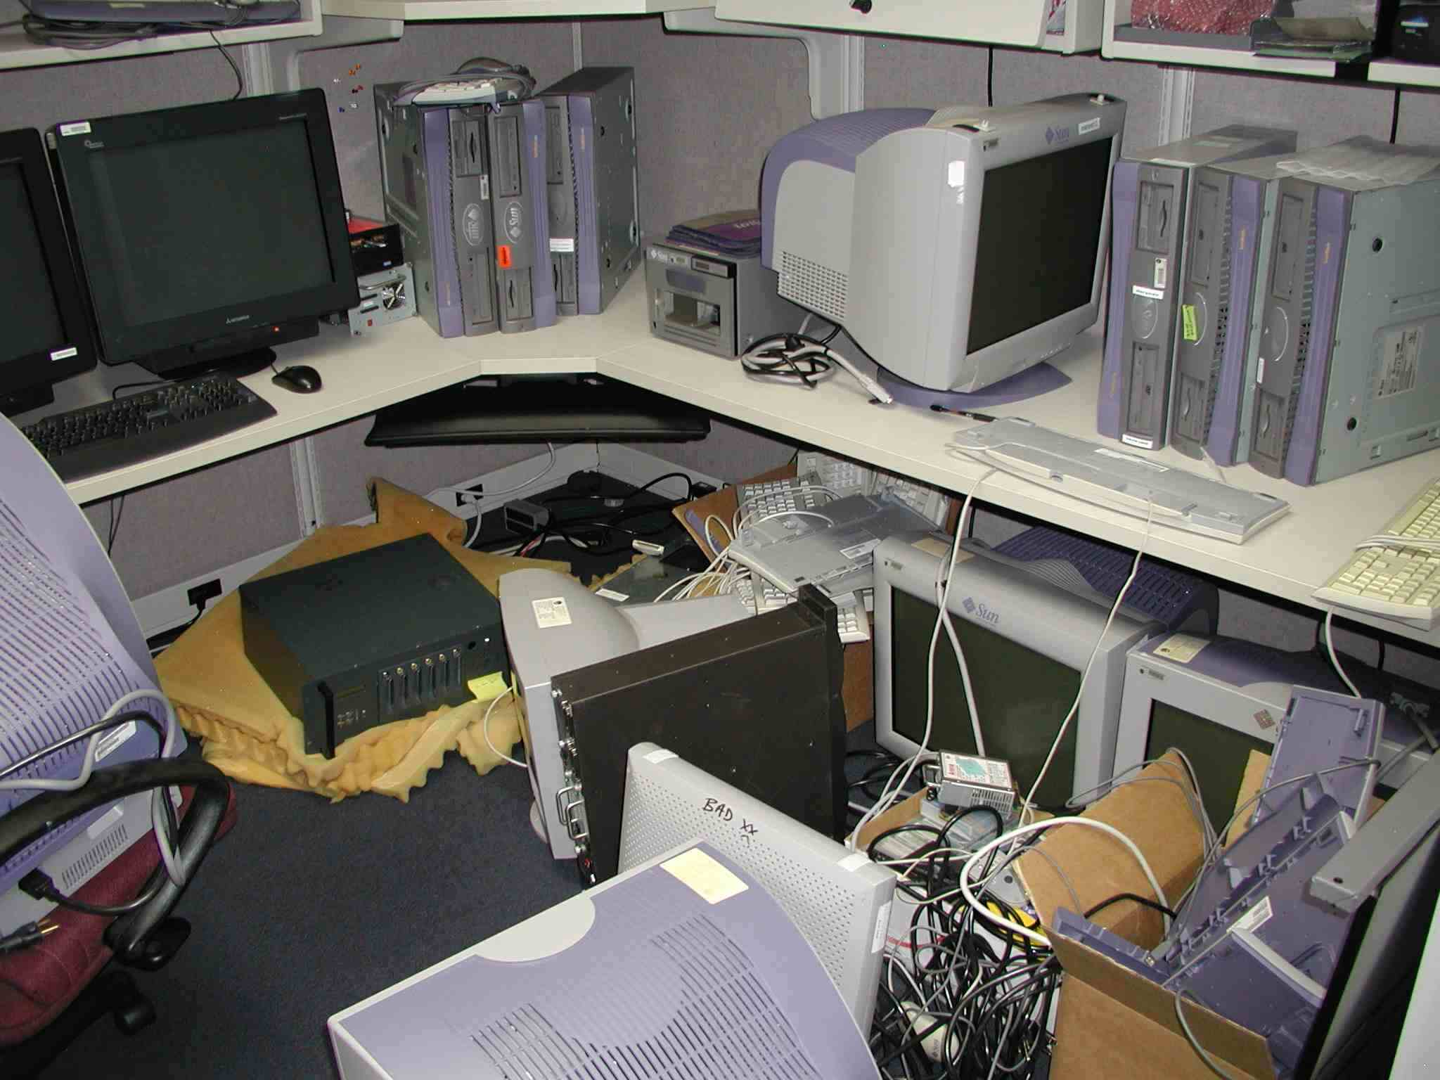
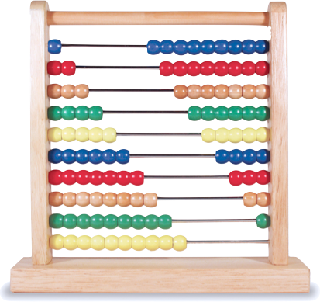
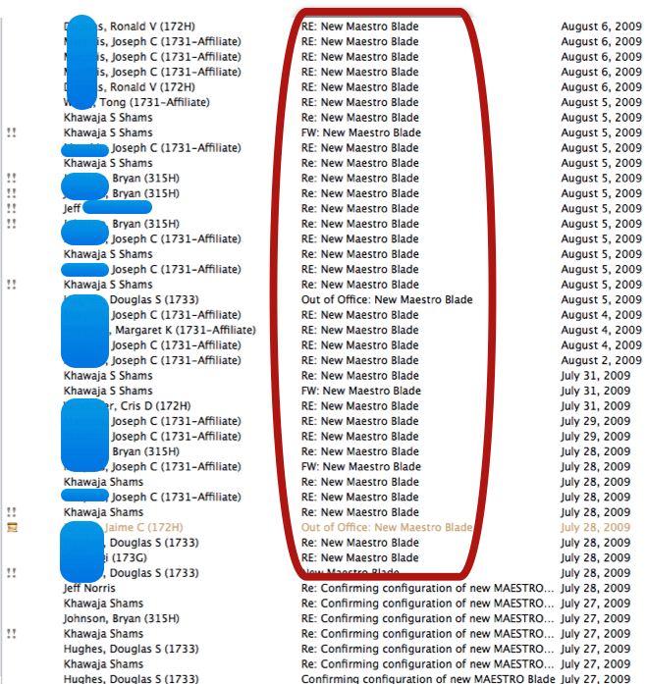
Traditional Approach to Infrastructure

Slide 8

Replace Every Procurement Screen with a Provisioning Screen.
Jim Rinaldi - CIO JPL

Slide 9
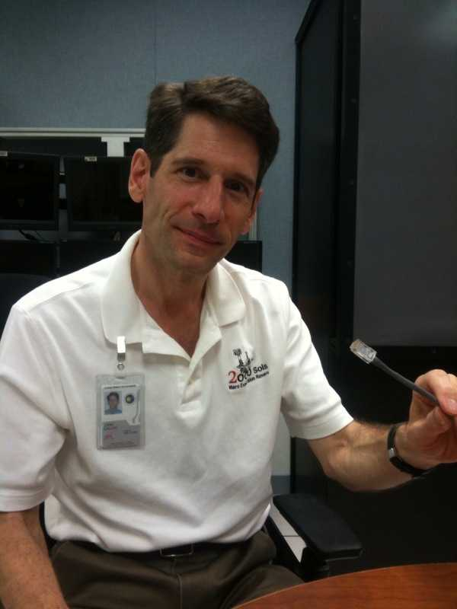
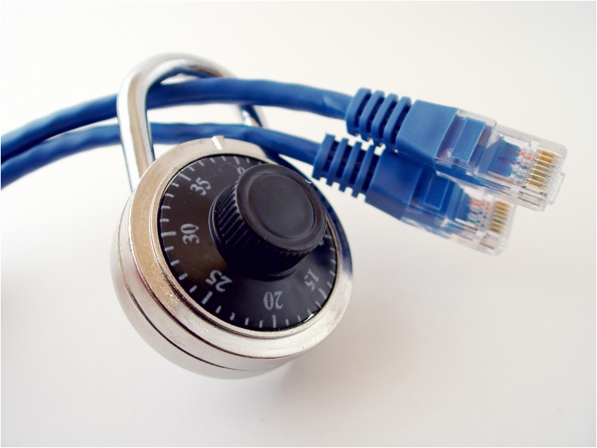
What Compute Capacity means to JPLers
John Callas, JPL

Slide 10
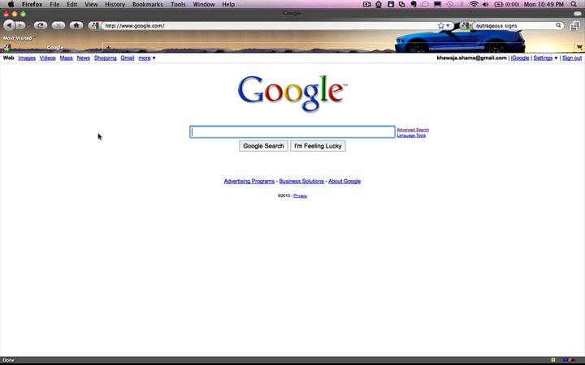
Here comes the rain…

Slide 11

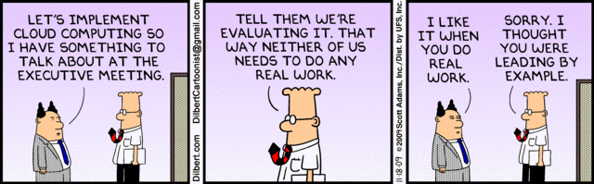
JPL’s approach to Cloud Computing
But how?
Focus on real business problems
Early hands-on prototypes of enabling capabilities in every promising cloud
Avoid analysis paralysis, but be safe
Educate, communicate, influence, elaborate
Keep it real
Pro-active partnering

Slide 12

Let’s Move to the Cloud!

Slide 13

Contract Negotiations!

Slide 14

First to Sign!

Slide 15
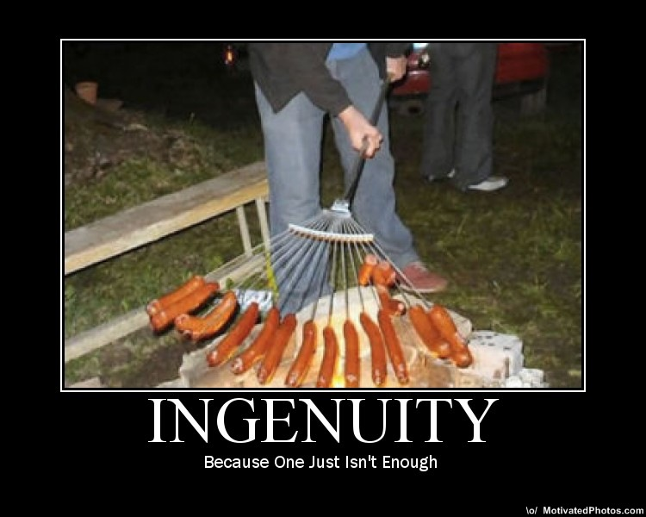
Fostering the IT Consumers’ Ingenuity
IT ➔ “Innovating Together”

Slide 16











JPL Partners
Keep it
real
Google
Microsoft

Slide 17
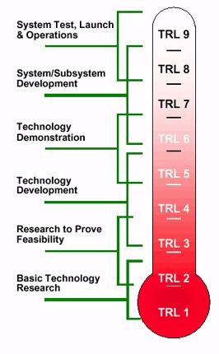
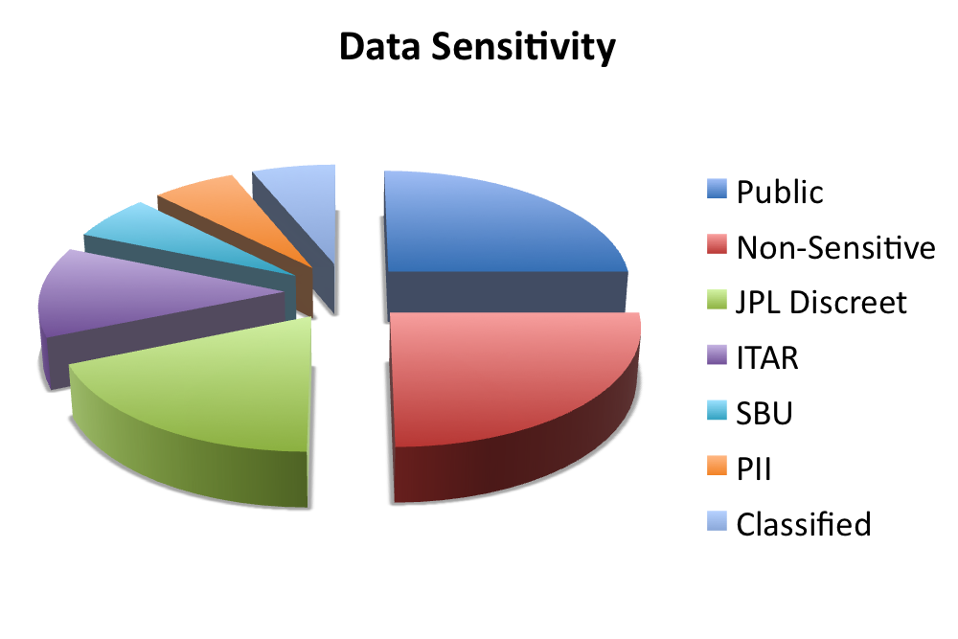
Cloud Computing Concepts
3. Cloud Readiness Levels (CRL)
(Institution, Apps, Dev)
1. Cloud Application
Suitability Model (CASM)
2. Wheel of Security
Public and Non-Sensitive data can be accessed
in the Cloud today
NASA Technology Readiness Level
http://en.wikipedia.org/wiki/File:NASA_TRL_Meter.jpg
4. Cloud Oriented Architecture (ClOA)

Slide 18
Cloud App Suitability Model determines application location
App Req’ts:
Security, ITAR,
app type, bandwidth, uptime, etc
Score | Cloud Type | Testing ➔ Need for a “Cloud Broker”
76-100 | Public | Recommends one of several
50-75 | Community or Hybrid | Recommend one of several
0-49 | Private or Hybrid | Recommendation
Private
Cloud
Private
Clouds
Community
Clouds
Private
Clouds
Community
Clouds
Community Cloud
Public
Clouds
Public
Clouds
Public Cloud
Today
Within 2 Years
Future
➔ We’ll become faster, cheaper, greener, more flexible, and a partner of choice

Slide 19

Data in Cloud
Public Data
Notes:
Decouple of the notion of privacy and physical location of data

Slide 20
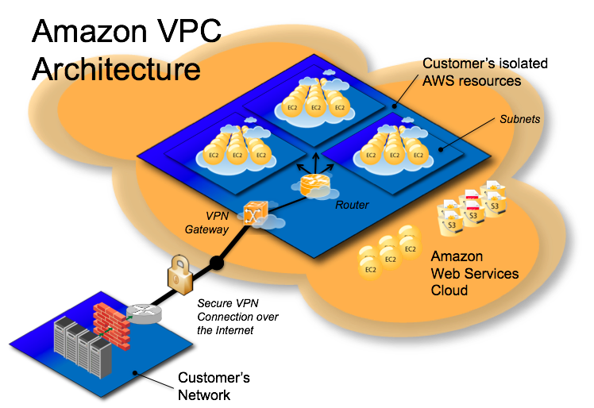
Virtual Private Cloud

Slide 21
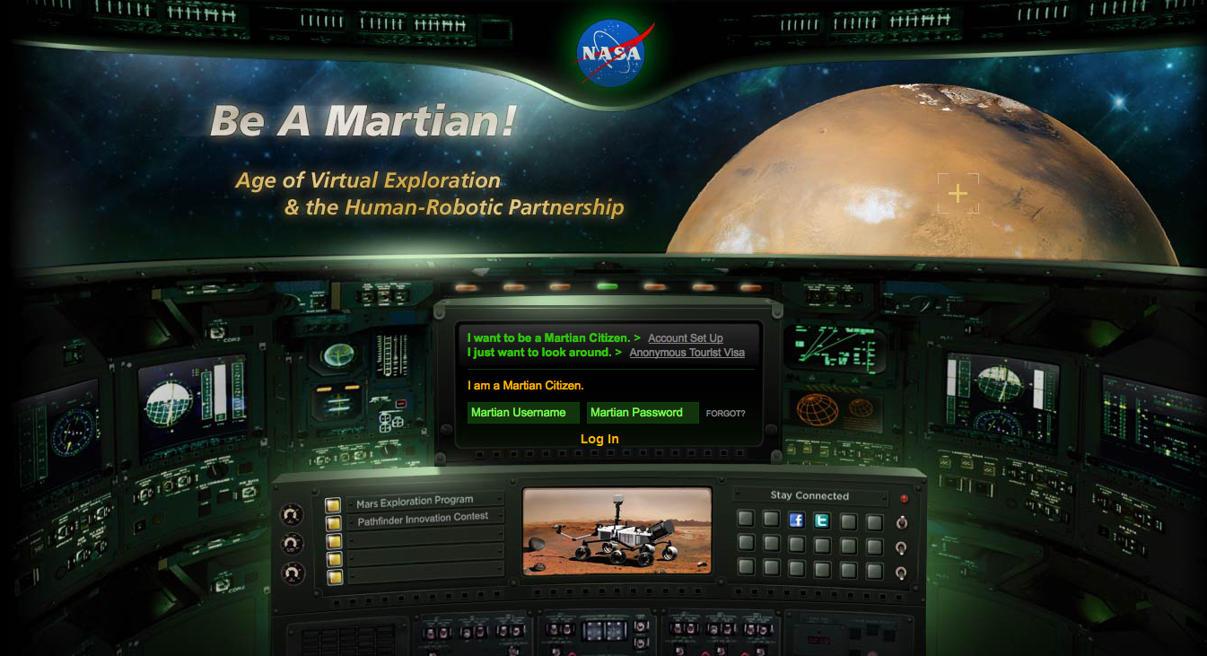
JPL Cloud Uses: Outreach for Citizen Scientists
BeaMartian.jpl.nasa.gov
Reaches MS Cloud developers / citizen scientists of all ages

Slide 22

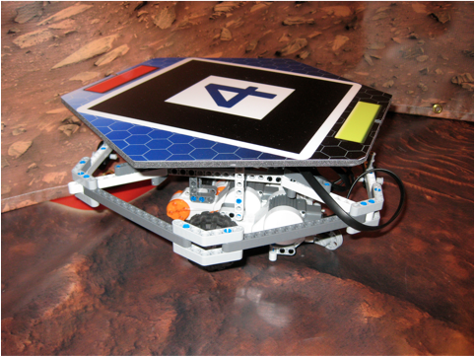




JPL Cloud Uses: Crowd Sourcing for E4 Rover
At EclipseCon 2010, a competition to drive a “Mars rover”
Innovative concepts. Great programs. Exciting and fun
It was all in Amazon’s Cloud (no JPL computing resources)

Slide 23

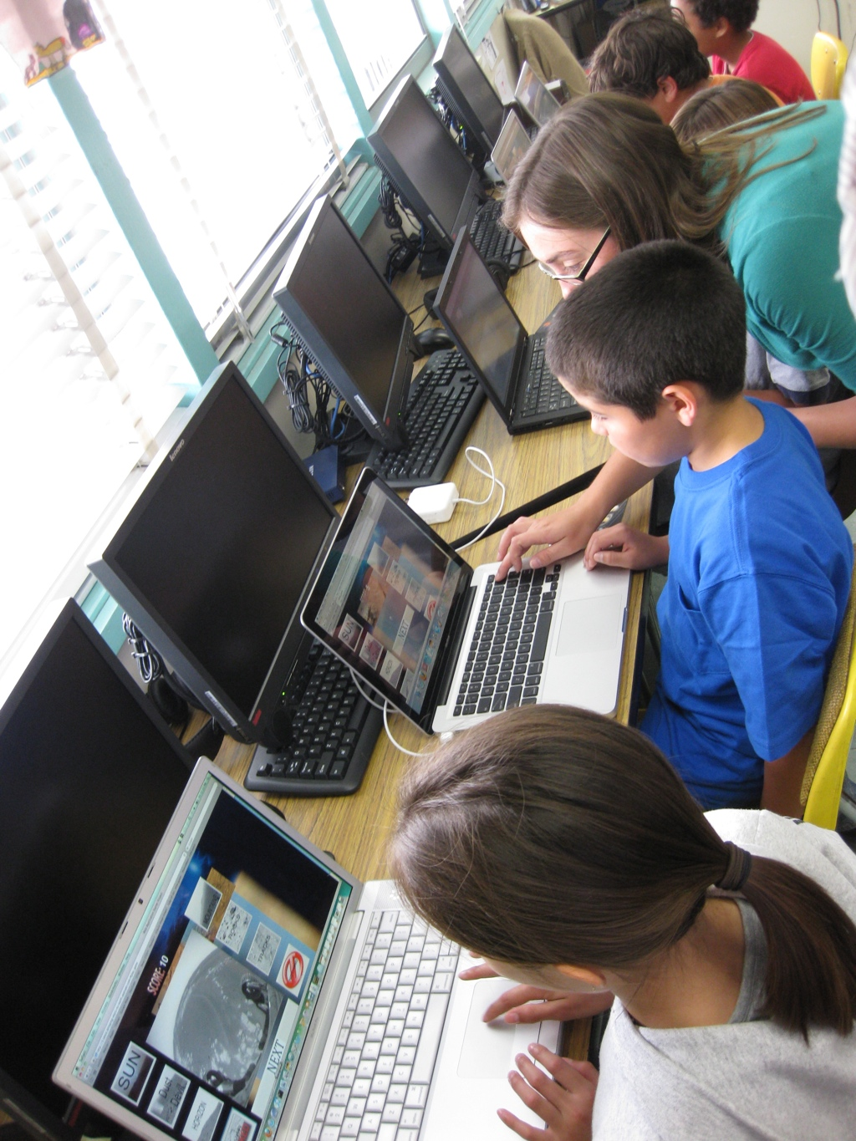



Mars-2-Earth

Slide 24
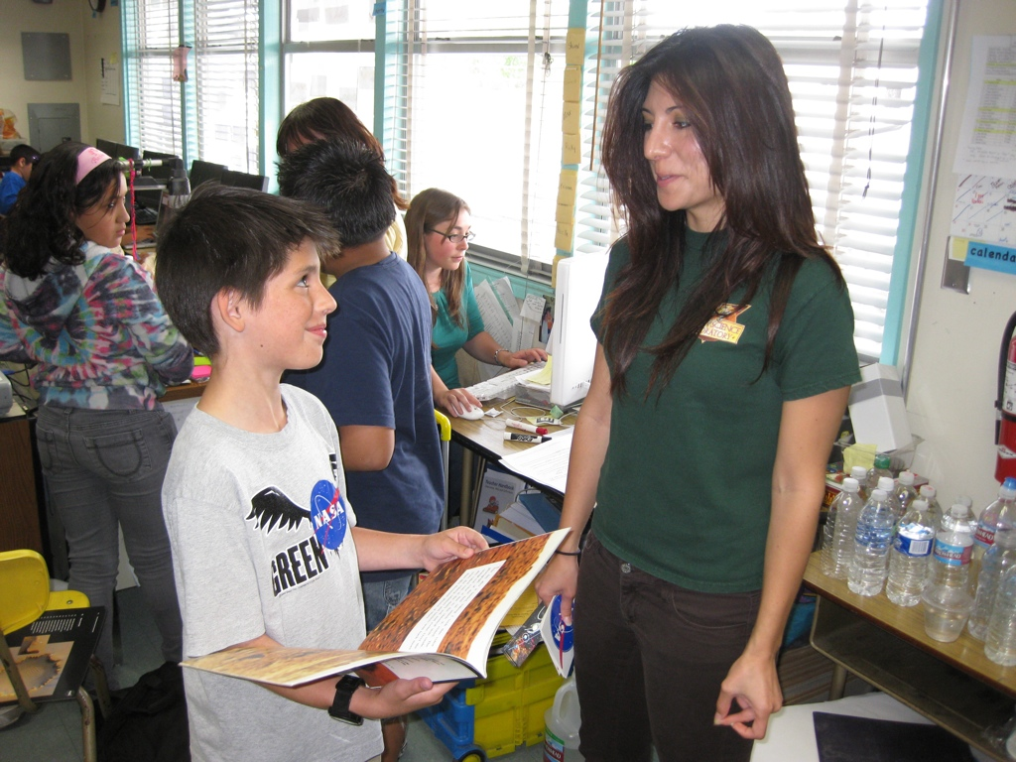
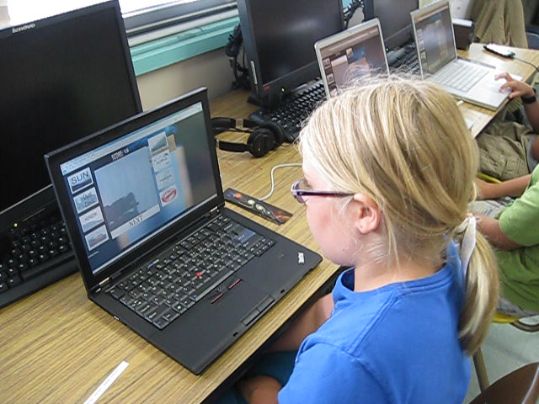
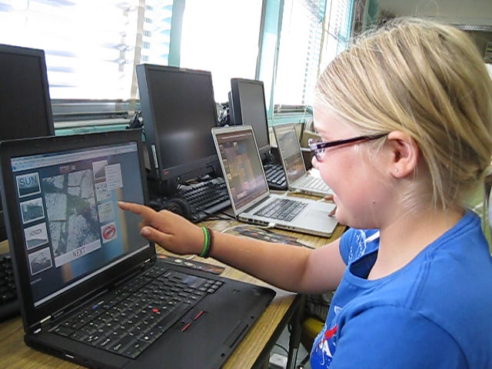
Mars-2-Earth

Slide 25
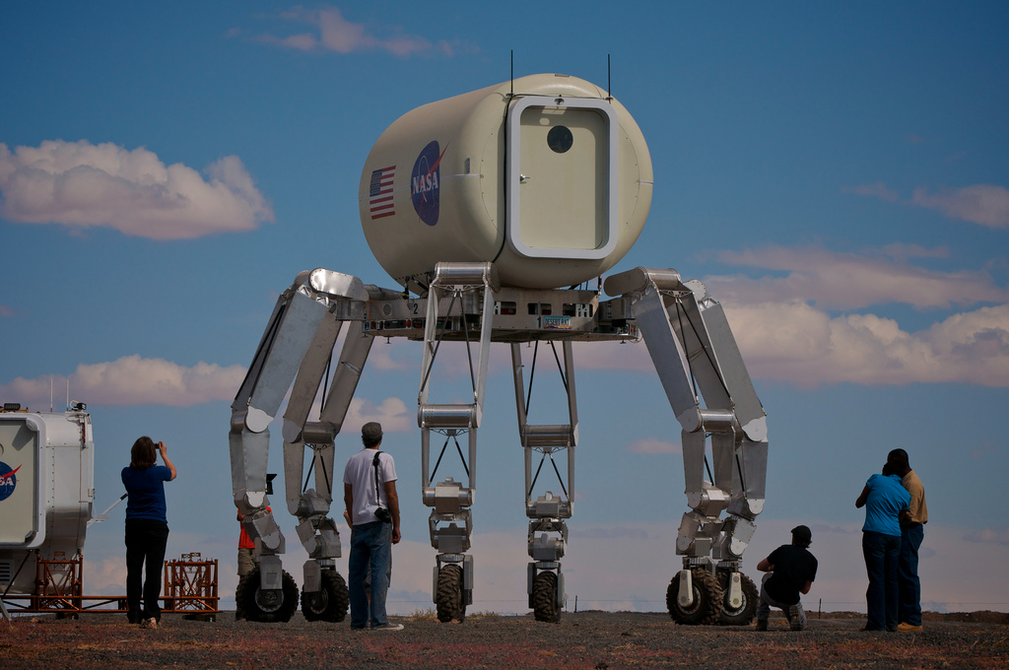
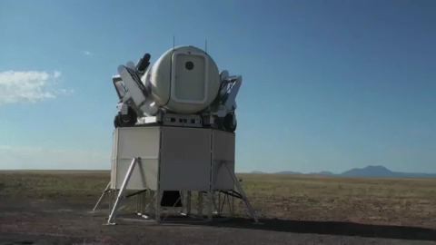
JPL Cloud Uses: Amazon HPC usage for Athlete
Notes:
ATHLETE – traversed 60 KM at the recent D-RATs field test
We used AWS cluster compute nodes to process images as large as 3.2 Gigapixels of the terrain to help provide situational awareness to the operators.
Cluster compute details:
Single tenant – 10Gb interconnect – fast machines suitable for many of the HPC computing needs at JPL

Slide 26
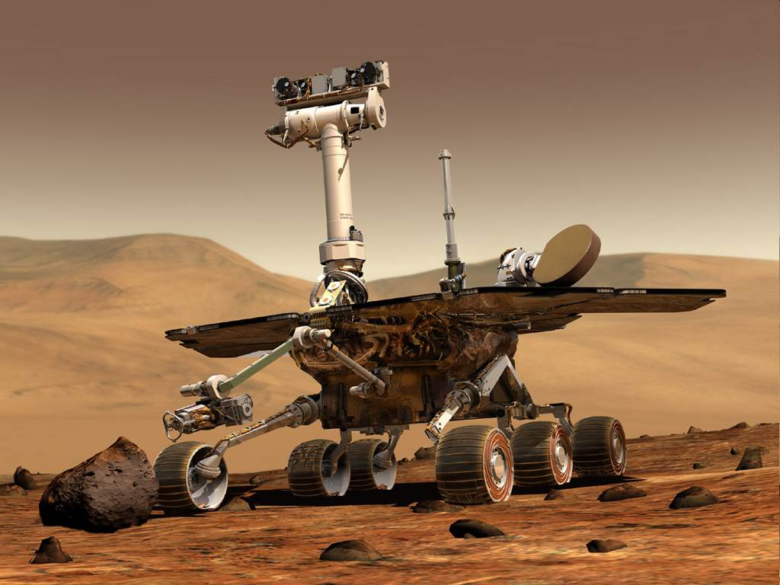
Mars Exploration Rovers

Slide 27

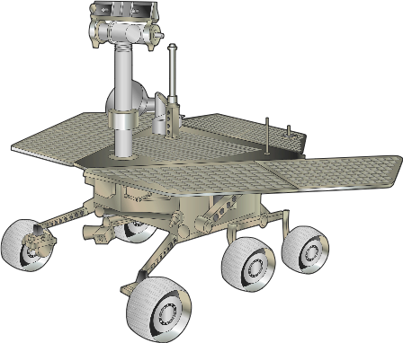
MER Image Processing
Embarrassingly parallel application
Process and deliver from Cloud
Streamlined image processing through Cloud Computing
Better situational awareness, better science, better safety

Slide 28
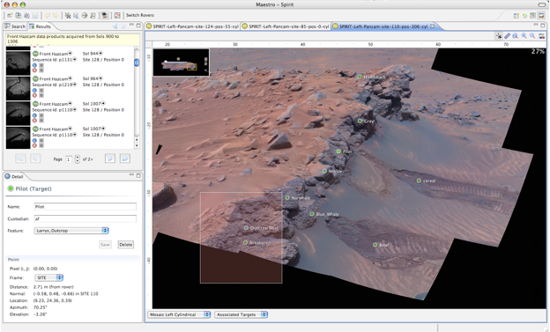
Maestro for MER

Slide 29
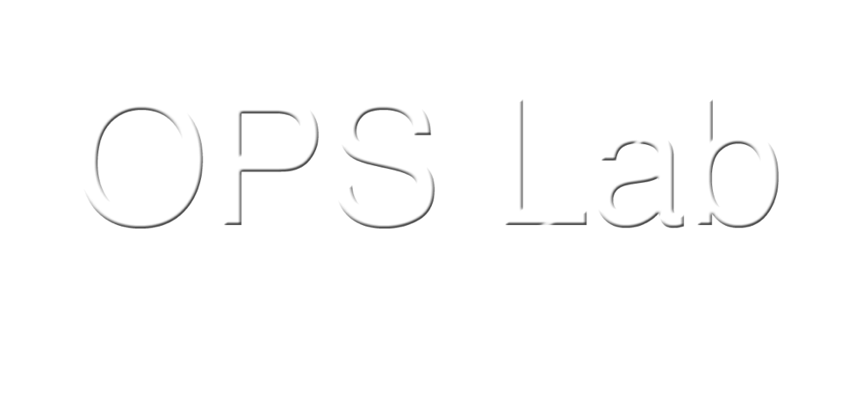
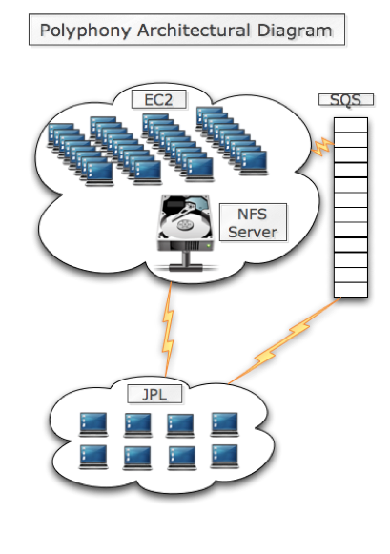



IMAGE PROCESSING ON CLOUD
POLYPHONY
~ Quarter Million Images
Quarter of a *day*
<$200
Weeks
Days

Slide 30
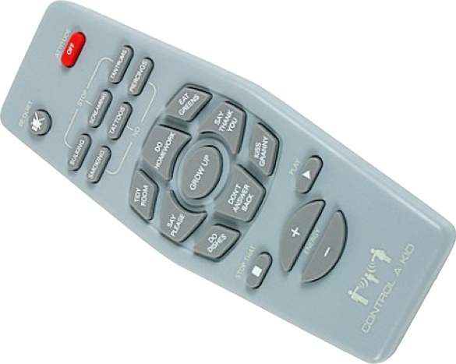
Physical Control

Slide 31
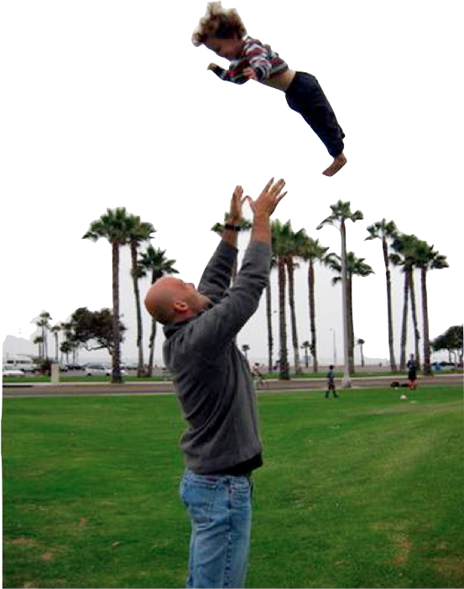
Who Do We Already Trust?

Slide 32
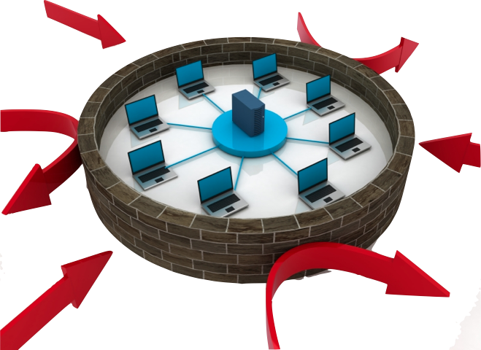
Can Clouds Be Safer?

Slide 33

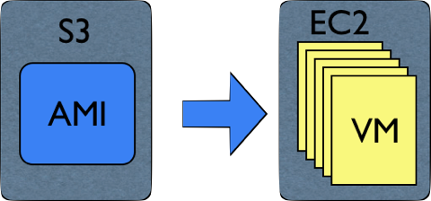
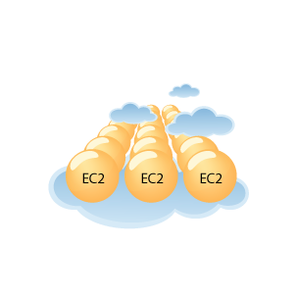
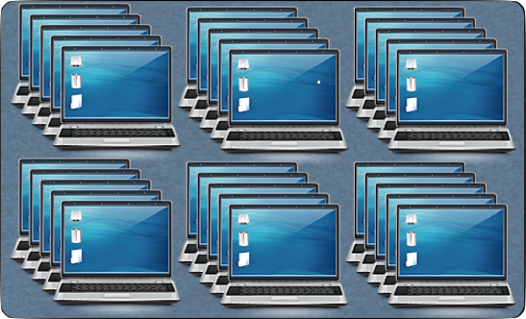
Security through Uniformity

Slide 34
JPL Cloud Uses: Observed Mission Benefits
A few examples of prototyped benefits so far:
From weeks to hours to process Saturn images
15% more time for scientists world wide on Mars rovers
From days to hours to model computations (e.g. DSN)
Can reduce ops costs
Can reduce risk
Can speed experiments
Augments JPL resources
Partnering pays off!

Slide 35
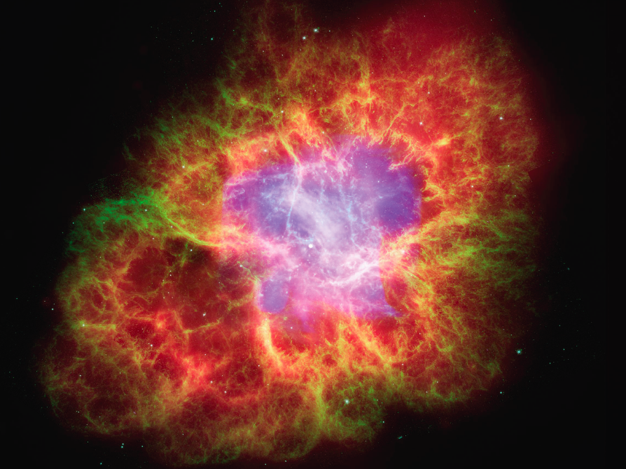
JPL Cloud Strategy: What’s next
35
➔ Cloud is THE enabler… if we continue to Keep it Real
Notes:
35

Slide 36
JPL Cloud Strategy: What’s next for JPL and Clouds
We transition from understanding the Cloud to working in the Cloud to partnering in the Cloud
The Cloud enables everything … if we let it (e.g. PC 3.0)
Specialized Clouds become the Operating System
JPL will advance the Cloud Readiness Levels (CRL) and Cloud Oriented Architecture (COA)
Transition Cloud from Pilot to Operational mode
Spin the Wheel of Security and evaluate more Use Cases
Automate the Cloud Application Suitability Model (CASM)
Continue to keep it real and benefit from employees’ and partners’ ingenious usage of Clouds
Take full advantage of the Pervasive Cloud

Slide 37

Can we live without making IT rain?

Slide 38
What can YOU do about Cloud computing?
Get started now with low sensitivity data
Focus on new capabilities
Prototype under the radar screen
Communicate it as a business initiative (ROA)
Partner with everyone
Use the 3-floor elevator test
Create a cross-functional leadership team focused on the concept (legal, procurement, security, facilities, business leaders, IT)
Expect license agreement to take time
Keep it real

